Slide 1

ETHICAL HACKING INTERNSHIP TASK-3
Submitted By – Sweta Upadhyay

Slide 2
Problem Statement
Task 3:
In this task you are completely free. http://testasp.vulnweb.com/ - This is the website. Explore the website and try to find vulnerabilities in the website and report it to us. You will be evaluated on your methods and report you submit. Don’t worry about evaluation, just report the vulnerabilities as you feel comfortable.

Slide 3
Vulnerability Statistics
Critical
28%
Severe
13%
Moderate
6%
Low
25%

Slide 4
Vulnerability 1 - Cross-site Scripting
Background:
Cross-site scripting, which allows an attacker to execute a dynamic script (JavaScript, VBScript) in the context of the application.
Cross-site Scripting (Important) | Impact There are many different attacks that can be leveraged through the use of cross-site scripting, including: Hijacking user's active session. Mounting phishing attacks. Intercepting data and performing man-in-the-middle attacks. Remedy The issue occurs because the browser interprets the input as active HTML, JavaScript or VBScript. To avoid this, output should be encoded according to the output location and context. For example, if the output goes in to a JavaScript block within the HTML document, then output needs to be encoded accordingly. Encoding can get very complex, therefore it's strongly recommended to use an encoding library such as OWASP ESAPI and Microsoft Anti-cross-site scripting Remedy References Microsoft Anti-XSS Library OWASP XSS Prevention Cheat Sheet OWASP AntiSamy Java

Slide 5
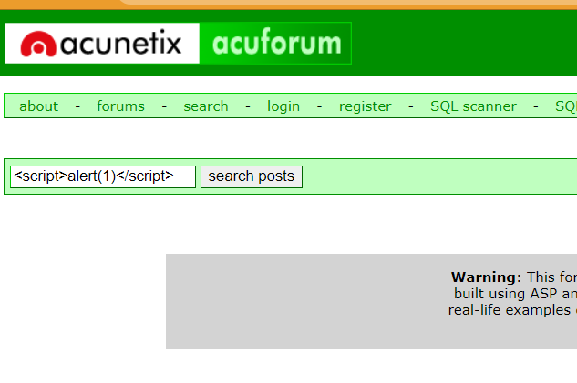
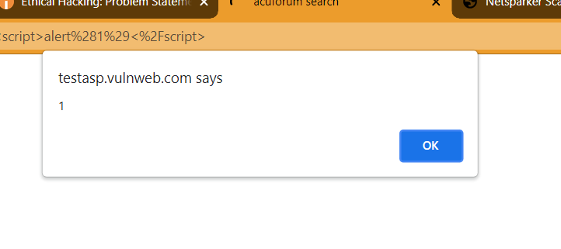
Proof of Concept (PoC)
Steps to be followed:
Open the search option
Type <script>alert(1)</script> in the search bar
Click search
An alert is generated confirming XSS vulnerability

Slide 6
Vulnerability 2 - SQL Injection
Background:
SQL injection is a web security vulnerability that allows an attacker to interfere with the queries that an application makes to its database.
Cross-site Scripting (Important) | Impact It generally allows an attacker to view data that they are not normally able to retrieve. This might include data belonging to other users, or any other data that the application itself is able to access. In many cases, an attacker can modify or delete this data, causing persistent changes to the application's content or behavior. Remedy The only sure way to prevent SQL Injection attacks is input validation and parametrized queries including prepared statements.

Slide 7
Proof of Concept (PoC)
Steps to be followed:
Open the login page
Check that on giving a random password, the login is invalid.
Now add a random username and add the password ‘OR ‘1’=‘1’ --
Now login is successful
This confirms the presence of SQL injection vulnerability

Slide 8
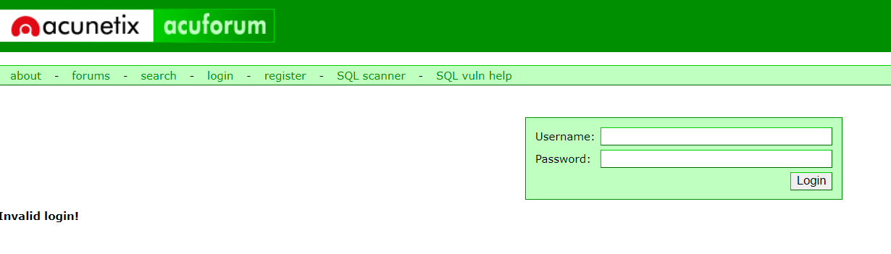
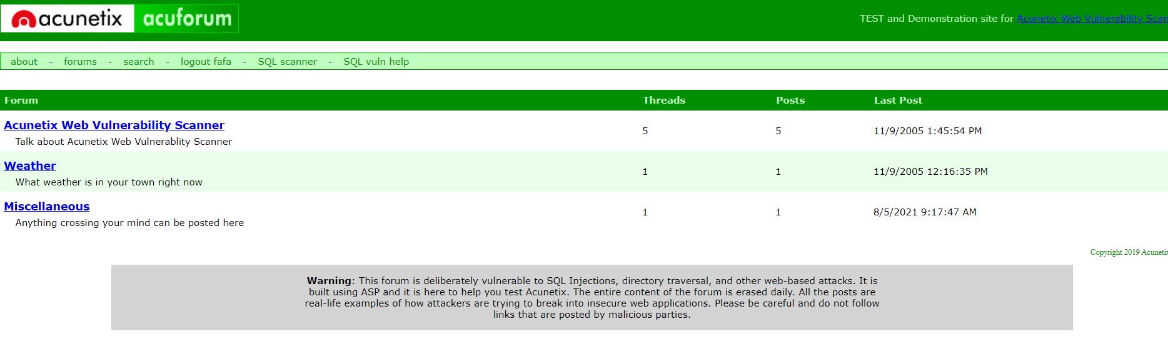
Proof of Concept (PoC)
After entering invalid credentials for login
After SQL injection we can easily login without credentials

Slide 9

PoC Video – Cross Site Scripting

Slide 10
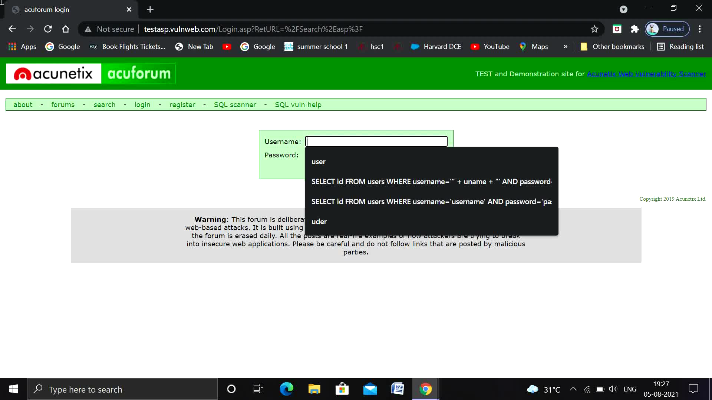
PoC Video – SQL Injection

Slide 11
Thank You!!

